Slide 1

Lecture 1 Module 1
Introduction to IoT
Tuesday:: 28th Jan:: 2025
Prof. Panchanan Nath :: Assistant Professor, Dept. of CSE :: NIST University :: Jan-July 25

Slide 2
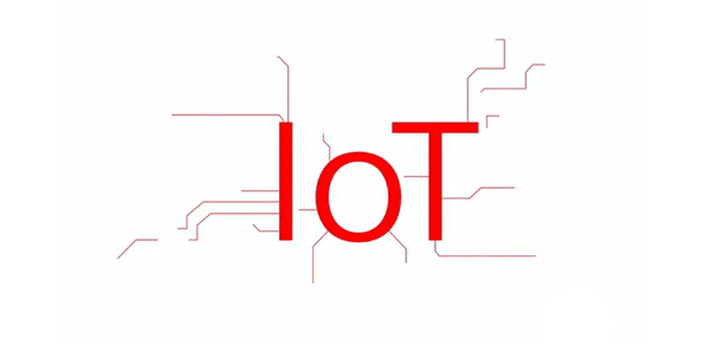
Outlines of the Discussion
Dfinition IoT
Characteristics of IoT
Physical Design of IoT
Logical Design of IoT
IoT Protocols
IoT Levels & Deployment Templates
Prof. Panchanan Nath :: Assistant Professor, Dept. of CSE :: NIST University :: Jan-July 25

Slide 3
Definition of IoT
A dynamic global network infrastructure with self-configuring capabilities based on standard and interoperable communication protocols where physical and virtual "things" have identities, physical attributes, and virtual personalities and use intelligent interfaces, and are seamlessly integrated into the information network, often communicate data associated with users and their environments
In simple words
IoT is a sensor network of billions of smart devices, that connects people, systems, and applications to collect, share, and process data.
Prof. Panchanan Nath :: Assistant Professor, Dept. of CSE :: NIST University :: Jan-July 25

Slide 4

Characteristics of IoT
Dynamic & Self-Adapting
Self-Configuring
Interoperable Communication Protocols
Unique Identity
Integrated into Information Network
Prof. Panchanan Nath :: Assistant Professor, Dept. of CSE :: NIST University :: Jan-July 25

Slide 5

Characteristics of IoT
Dynamic & Self-Adapting
IoT devices and systems have the dynamic adaption capability to different contexts and take actions based on their operating conditions, user's context, or sensed environment.
For example:
Consider a surveillance system comprising of several surveillance cameras.
The surveillance cameras can adapt their modes (to normal or infra-red night modes) based on whether it is day or night.
Interoperable Communication Protocols
Unique Identity
Integrated into Information Network
Prof. Panchanan Nath :: Assistant Professor, Dept. of CSE :: NIST University :: Jan-July 25
Notes:
Cameras could switch from lower resolution to higher resolution modes when any motion is detected and alert nearby cameras to do the same. In this example, the surveillance system is adapting itself based on the context and changing (e.g., dynamic) conditions.

Slide 6

Characteristics of IoT
Dynamic & Self-Adapting
Self-Configuring
IoT devices may have self-configuring capability, allowing a large number of devices to work together to provide certain functionality (such as weather monitoring).
These devices have the ability configure themselves (in association with the IoT infrastructure), setup the networking, and fetch latest software upgrades with minimal manual or user intervention.
Interoperable Communication Protocols
Unique Identity
Integrated into Information Network
Prof. Panchanan Nath :: Assistant Professor, Dept. of CSE :: NIST University :: Jan-July 25

Slide 7
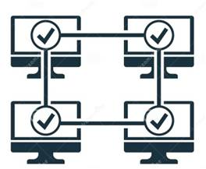
Characteristics of IoT
Dynamic & Self-Adapting
Self-Configuring
Interoperable Communication Protocols
IoT devices support a number of interoperable communication protocols and can communicate with other devices and also with the infrastructure.
Unique Identity
Integrated into Information Network
Prof. Panchanan Nath :: Assistant Professor, Dept. of CSE :: NIST University :: Jan-July 25

Slide 8

Characteristics of IoT
Dynamic & Self-Adapting
Self-Configuring
Interoperable Communication Protocols
Unique Identity
Each IoT device has a unique identity and a unique identifier (an IP address).
IoT systems may have intelligent interfaces which adapt based on the context, allow communicating with users and the environmental contexts.
Integrated into Information Network
Prof. Panchanan Nath :: Assistant Professor, Dept. of CSE :: NIST University :: Jan-July 25

Slide 9

Characteristics of IoT
Dynamic & Self-Adapting
Self-Configuring
Interoperable Communication Protocols
Unique Identity
Integrated into Information Network
IoT devices can be dynamically discovered in the network, by other devices and/or the network, and have the capability to describe themselves (and their characteristics) to other devices or user applications.
For example:
The weather monitoring node can describe its monitoring capabilities to another connected node so that they can communicate and exchange data.
Prof. Panchanan Nath :: Assistant Professor, Dept. of CSE :: NIST University :: Jan-July 25
Notes:
IoT devices are usually integrated into the information network that allows them to communicate and exchange data with other devices and systems.
Integration into the information network helps in making IoT systems "smarter" due to the collective intelligence of the individual devices in collaboration with the infrastructure. Thus, the data from a large number of connected weather monitoring IoT nodes can be aggregated and analyzed to predict the weather.

Slide 10
Physical Design IoT
The "Things" in IoT usually refers to IoT devices which have unique
identities and can perform remote sensing, actuating and monitoring
capabilities
IoT devices can:
Exchange data with other connected devices and applications (directly or indirectly)
Collect data from other devices and process the data locally or Send the data to centralized servers or cloud-based application back-ends for processing the data
Perform some tasks locally and other tasks within the IoT infrastructure, based on temporal and space constraints
Prof. Panchanan Nath :: Assistant Professor, Dept. of CSE :: NIST University :: Jan-July 25
Notes:
IoT devices are usually integrated into the information network that allows them to communicate and exchange data with other devices and systems.
Integration into the information network helps in making IoT systems "smarter" due to the collective intelligence of the individual devices in collaboration with the infrastructure. Thus, the data from a large number of connected weather monitoring IoT nodes can be aggregated and analyzed to predict the weather.

Slide 11
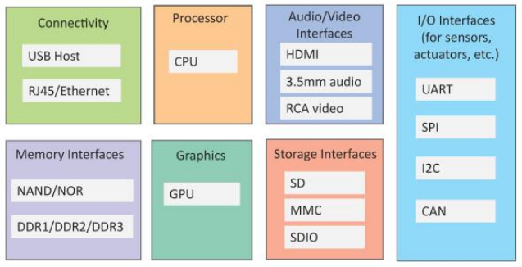
Generic block diagram of an IoT
An IoT device consist of several interfaces for connections to other devices, through both wired and wireless.
I/O interfaces for sensors
Interfaces for Internet connectivity
Memory and storage interfaces
Audio/video interface
Fig: Generic block diagram of an IoT
Prof. Panchanan Nath :: Assistant Professor, Dept. of CSE :: NIST University :: Jan-July 25
Notes:
IoT devices are usually integrated into the information network that allows them to communicate and exchange data with other devices and systems.
Integration into the information network helps in making IoT systems "smarter" due to the collective intelligence of the individual devices in collaboration with the infrastructure. Thus, the data from a large number of connected weather monitoring IoT nodes can be aggregated and analyzed to predict the weather.

Slide 12
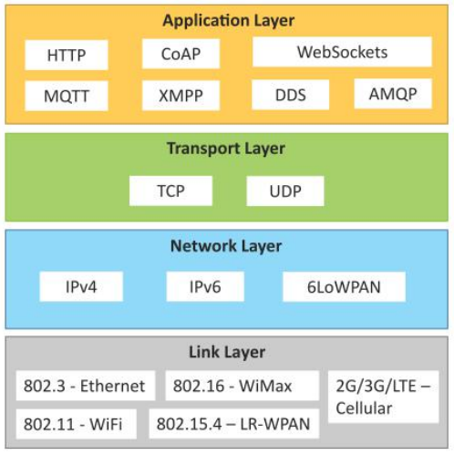
IoT Protocols
Link Layer
802.3 – Ethernet
802.11 – WiFi
802.16 – WiMax
802.15.4 – LR-WPAN
2G/3G/4G
Network/Internet Layer
IPv4 : Internal Protocol version 4
IPv6 : Internal Protocol version 6
6LoWPAN : IPv6 over Low-Power Wireless Personal Area Networks
Transport Layer
TCP : Transmission Control Protocol
UDP : User Datagram Protocol
Application Layer
HTTP : Hypertext Transfer Protocol
CoAP : Constrained Application Protocol
WebSocket : WebSocket
MQTT : Message Queuing Telemetry Transport
XMPP : Extensible Messaging and Presence Protocol
DDS : Data Distribution Service
AMQP : Advanced Message Queuing Protocol
Fig: IoT Protocols
Prof. Panchanan Nath :: Assistant Professor, Dept. of CSE :: NIST University :: Jan-July 25
Notes:
IoT devices are usually integrated into the information network that allows them to communicate and exchange data with other devices and systems.
Integration into the information network helps in making IoT systems "smarter" due to the collective intelligence of the individual devices in collaboration with the infrastructure. Thus, the data from a large number of connected weather monitoring IoT nodes can be aggregated and analyzed to predict the weather.

Slide 13
IoT Protocols :: Link Layer
Link layer protocols determine how the data is physically sent over the network's physical layer or medium (e.g., copper wire, coaxial cable, or a radio wave).
The scope of the link layer is the local network connection to which host is attached. Hosts on the same link exchange data packets over the link layer using link layer protocols.
Link layer determines how the packets are coded and signaled by the hardware device over the medium to which the host is attached (such as a coaxial cable). Let us now look at some link layer protocols which are relevant in the context of IoT.
802.3 – Ethernet
It is a collection of wired Ethernet standards for the link layer.
For example, 802.3 is the standard for 10 BASES Ethernet that uses coaxial cable as a shared medium, 802.3.i is the standard for 10BASE-T Ethernet over copper twisted-pair connections, 802.3.j is the standard for 10BASE-F Ethernet over fiber optic connections, 802.3ae is the standard for 10 Gbit/s Ethernet over fiber, and so on.
These standards provide data rates from 10 Mb/s to 40 Gb/s and higher. The shared medium in Ethernet can be a coaxial cable, twisted-pair wire or an optical fiber.
The shared medium (i.e., broadcast medium) carries the communication for all the devices on the network, thus data sent by one device can received by all devices subject to propagation conditions and transceiver capabilities.
802.11 – WiFi
802.16 – WiMax
802.15.4 – LR-WPAN
2G/3G/4G
Prof. Panchanan Nath :: Assistant Professor, Dept. of CSE :: NIST University :: Jan-July 25
Notes:
IoT devices are usually integrated into the information network that allows them to communicate and exchange data with other devices and systems.
Integration into the information network helps in making IoT systems "smarter" due to the collective intelligence of the individual devices in collaboration with the infrastructure. Thus, the data from a large number of connected weather monitoring IoT nodes can be aggregated and analyzed to predict the weather.

Slide 14
IoT Protocols :: Link Layer
802.3 – Ethernet
802.11 – WiFi
IEEE 802.11 is a collection of wireless local area network (WLAN) communication standards.
For example, 802.11a operates in the 5 GHz band, 802.11b and 802.11g operate in the 2.4 GHz band, 802.11n operates in the 2.4/5 GHz bands, 802.11ac operates in the 5 GHz band and 802.11ad operates in the 60 GHz band.
These standards provide data rates from 1 Mb/s to upto 6.75 Gb/s.
802.16 – WiMax
IEEE 802.16 is a collection of wireless broadband standards. WiMax standards provide data rates from 1.5 Mb/s to 1 Gb/s. The recent update (802.16m) provides data rates of 100 Mbit/s for mobile stations and 1 Gbit/s for fixed stations.
802.15.4 – LR-WPAN
2G/3G/4G
Prof. Panchanan Nath :: Assistant Professor, Dept. of CSE :: NIST University :: Jan-July 25
Notes:
IoT devices are usually integrated into the information network that allows them to communicate and exchange data with other devices and systems.
Integration into the information network helps in making IoT systems "smarter" due to the collective intelligence of the individual devices in collaboration with the infrastructure. Thus, the data from a large number of connected weather monitoring IoT nodes can be aggregated and analyzed to predict the weather.

Slide 15
IoT Protocols :: Link Layer
802.3 – Ethernet
802.11 – WiFi
802.16 – WiMax
802.15.4 – LR-WPAN
IEEE 802.15.4 is a collection of standards for low-rate wireless personal area networks (LR-WPANs). These standards form the basis of specifications for high level communication protocols such as ZigBee.
LR-WPAN standards provide data rates from 40 Kb/s to 250 Kb/s. These standards provide low-cost and low-speed communication for power constrained devices.
2G/3G/4G
There are different generations of mobile communication standards including second generation (2G including GSM and CDMA), third generation (3G - including UMTS and CDMA2000) and fourth generation (4G - including LTE).
IoT devices based on these standards can communicate over cellular.
Prof. Panchanan Nath :: Assistant Professor, Dept. of CSE :: NIST University :: Jan-July 25
Notes:
IoT devices are usually integrated into the information network that allows them to communicate and exchange data with other devices and systems.
Integration into the information network helps in making IoT systems "smarter" due to the collective intelligence of the individual devices in collaboration with the infrastructure. Thus, the data from a large number of connected weather monitoring IoT nodes can be aggregated and analyzed to predict the weather.

Slide 16
IoT Protocols :: Network Layer
The network layers are responsible for sending of IP datagrams from the source network to the destination network.
Performs the host addressing and packet routing.
The datagrams contain the source and destination addresses which are used to route them from the source to destination across multiple networks.
Host identification is done using hierarchical IP addressing schemes such as IPv4 or IPv6.
IPv4: uses a 32-bit address scheme that allows total of 2 power 32 or 4,294,967,296 addresses. As more and more devices got connected to the Internet, these addresses got exhausted in the year 2011.
IPv6: uses 128-bit address scheme that allows total of 2 power 128 or 3.4 x 1038 addresses.
6LoWPAN: IPv6 over Low power Wireless Personal Area Networks) brings IP protocol to the low-power devices which have limited processing capability.
It operates in the 2.4 GHz frequency range and provides data transfer rates of 250 Kb/s and defines compression mechanisms for IPv6 datagrams over IEEE 802.15.4-based networks.
Prof. Panchanan Nath :: Assistant Professor, Dept. of CSE :: NIST University :: Jan-July 25
Notes:
IPv4 has been succeeded by IPv6. The IP protocols establish connections on packet networks, but do not guarantee delivery of packets. Guaranteed delivery and data integrity are handled by the upper layer protocols (such as TCP).

Slide 17
IoT Protocols :: Transport Layer
The transport layer protocols provide end-to-end message transfer capability independent of the underlying network. The message transfer capability can be set up on connections, either using handshakes (as in TCP) or without handshakes/acknowledgements (as in UDP).
The transport layer provides functions such as error control, segmentation, flow control and congestion control.
TCP: Transmission Control Protocol (TCP) is used by web browsers (along with HTTP, HTTPS application layer protocols), email programs (SMTP application layer protocol) and file transfer (FTP).
TCP is a connection oriented and stateful protocol.
While IP protocol deals with sending packets, TCP ensures reliable transmission of packets in-order.
TCP also provides error detection capability and lost packets are retransmitted.
The flow control capability of TCP ensures that rate at which the sender sends the data is not too high for the receiver to process.
he congestion control capability of TCP helps in avoiding network congestion and congestion collapse which can lead to degradation of network performance.
UDP: User Datagram Protocol
Prof. Panchanan Nath :: Assistant Professor, Dept. of CSE :: NIST University :: Jan-July 25

Slide 18
IoT Protocols :: Transport Layer
TCP: Transmission Control Protocol
UDP: User Datagram Protocol
UDP is a connectionless protocol.
UDP is useful for time-sensitive applications that have very small data units to exchange and do not want the overhead of connection setup.
UDP is a transaction oriented and stateless protocol. UDP does not provide guaranteed delivery, ordering of messages and duplicate elimination. Higher levels of protocols can ensure reliable delivery or ensuring connections created are reliable.
Prof. Panchanan Nath :: Assistant Professor, Dept. of CSE :: NIST University :: Jan-July 25

Slide 19
IoT Protocols :: Application Layer
Application layer protocols define how the applications interface with the lower layer protocols to send the data over the network. The application data, typically in files, is encoded by the application layer protocol and encapsulated in the transport layer protocol which provides connection or transaction oriented communication over the network.
Port numbers are used for application addressing (for example port 80 for HTTP, port 22 for SSH, etc.).
Application layer protocols enable process-to-process connections using ports.
HTTP : Hypertext Transfer Protocol
CoAP : Constrained Application Protocol
WebSocket : WebSocket
MQTT : Message Queuing Telemetry Transport
XMPP : Extensible Messaging and Presence Protocol
DDS : Data Distribution Service
AMQP : Advanced Message Queuing Protocol
Prof. Panchanan Nath :: Assistant Professor, Dept. of CSE :: NIST University :: Jan-July 25

Slide 20
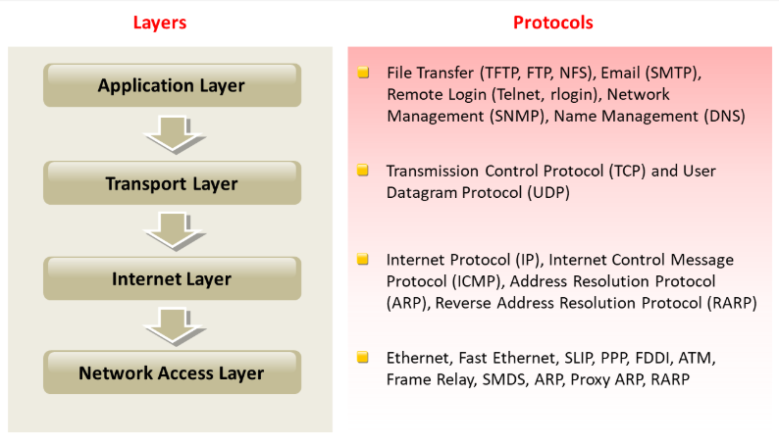
TCP/IP VS IoT Protocols
Fig: TCP/IP Protocols
Fig: IoT Protocols
Prof. Panchanan Nath :: Assistant Professor, Dept. of CSE :: NIST University :: Jan-July 25
Notes:
IoT devices are usually integrated into the information network that allows them to communicate and exchange data with other devices and systems.
Integration into the information network helps in making IoT systems "smarter" due to the collective intelligence of the individual devices in collaboration with the infrastructure. Thus, the data from a large number of connected weather monitoring IoT nodes can be aggregated and analyzed to predict the weather.

Slide 21
References
Books:
Chapter 1: Internet of Things A Hands-On- Approach by Arshdeep Bahga and Vijay Madisetti
Prof. Panchanan Nath :: Assistant Professor, Dept. of CSE :: NIST University :: Jan-July 25

Slide 22
Thank You
Q & A
Any Question?
Prof. Panchanan Nath :: Assistant Professor, Dept. of CSE :: NIST University :: Jan-July 25

